Slide 1

Objectives
In this session, you will learn to:
  Define products and services
  Identify the sales and marketing processes
  Determine how to use information systems for sales and marketing
Notes:
Use this slide to explain the objective of the session to the students.

Slide 2
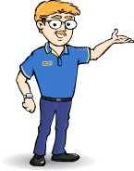
Defining Service Standards
In the previous session, we discussed product standards.
Notes:
Use this and the following slides to explain the ERP modules and its features.

Slide 3
Defining Service Standards (Contd.)
Now, let’s discuss about the service standards.
Notes:
Use this and the following slides to explain the ERP modules and its features.

Slide 4
Defining Service Standards (Contd.)
A service, like a product, is designed to address customer requirements and provide value for money.
Services may require human intervention or may be fully automated.
For example, credit card companies provide toll-free numbers that allow customers to obtain information about their existing accounts.

Slide 5
Defining Service Standards (Contd.)
Organizations providing products/services follow standards to achieve the following goals:
  Increase the market share
  Ensure customer satisfaction

Slide 6
The Product Life Cycle
The life cycle of a product starts when it is launched in the market till the time it remains in the market.
The different stages of a product lifecycle are:
  Introduction: Involves making the customer aware of the product and its benefits
  Growth: Involves maintaining the quality and price of the product to attract more customers.
  Maturity: Involves promoting the product by differentiating it from the competitors’ product.
  Decline: Involves maintaining the product by adding new features.

Slide 7
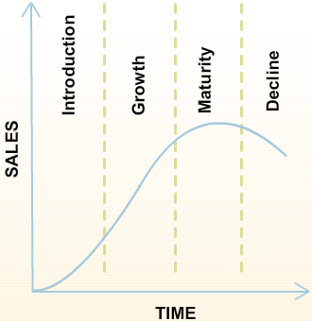
The Product Life Cycle (Contd.)
The following figure depicts the different stages of product life cycle.

Slide 8
Identifying the Marketing Processes
The marketing process:
  Defines market segments, their size, and the requirements of customers.
  Helps promote the product, ensure customer satisfaction, and generate revenue.

Slide 9
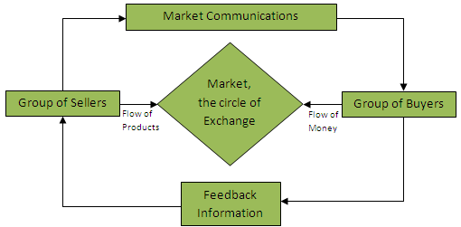
Identifying the Marketing Processes (Contd.)
The following figure depicts the marketing process.

Slide 10
Identifying the Marketing Processes (Contd.)
The stages in the marketing process are:
  Analyzing the need for product
  Deciding upon the marketing strategy
  Implementing the marketing strategy
  Monitoring the product

Slide 11

Identifying the Sales Processes
What is a sales process?
Notes:
Use the slide and the next slide to initiate a classroom discussion by introducing business processes and the need to be familiar with them in any business organization.
Organizational Setup
Based on Profit
All organizations work for commercial gain. Examples of organizations that are based on profit include:
NIIT, Wipro, and Ranbaxy.
However, some organizations may not have commercial gains as the key focus area. Examples include:
Red Cross and World Health Organization (WHO). Red Cross collects money in the form of charity and donations, and then utilizes these funds for providing social services to the people.
Based on System Type
A system is a group of interdependent components that perform their respective functions to achieve the end objective or goal of the organization.
An organization’s system type should be steadied in isolation. The same system could be considered open or closed depending on the perspective and the factors one is considering for discussion.
Cite the following examples while discussing the classification of organizations based on system types:
Simple/Complex:
Consultancy firms in the corporate world have a limited number of processes, but these are well defined.
Architects on the other hand do not have any well-defined processes.
Adaptive/Non Adaptive:
The size, complexity and functions that an organization carries to meet its objectives define the type of system it adopts or adapts. The food industry is very adaptive as compared to the automobile industry. The automobile industry needs to take many more factors into account before deciding on a change.
Usually bigger companies take a longer time to adapt as compared to the smaller ones.
In traditional systems performance, measurement parameters and scope are missing, for example the government-run departments. Traditional systems are driven by a 'boss', but contemporary systems are driven by a 'leader'.
Based on Ownership
A Corporation is organized and governed by articles of law. Examples of some laws: Companies Act, 1956, Competition Act, 2002, etc.
Sole proprietorship:
Advantages: Sole proprietorship is simple and flexible. The business set up can be established, bought, sold, modified or closed in a short time span. No organizational level charters or bylaws are required for this type of business venture. Other than the normal permits or licenses required for any business activity, no public notifications or legal issues are required for starting, terminating, redirecting, or modifying the business. A single family (proprietor) can own the business so the size or the complexity of the business can change if the proprietor has the finances available.
Limitations: The proprietor and family own the risk both personally and professionally unless assets (the property or funds owned by an individual or organization) are safeguarded, by creating a trust or treating them as separate entities. There may not be enough resources to support the business and hence limited capacity to respond to business opportunities. The business might end with the demise of the proprietor so the next generation must purchase or inherit the business assets by paying the applicable taxes and costs. Merging of household and business finances makes it difficult to measure the performance of the business in terms of profitability and performance. Conflicts in the family, if the family is involved in the business, can paralyze the business processes and functions leading to loss of revenue.

Slide 12

Identifying the Sales Processes (Contd.)
A sales process is used to sell a particular product/service to a particular set of customers.
Notes:
Use the slide and the next slide to initiate a classroom discussion by introducing business processes and the need to be familiar with them in any business organization.
Organizational Setup
Based on Profit
All organizations work for commercial gain. Examples of organizations that are based on profit include:
NIIT, Wipro, and Ranbaxy.
However, some organizations may not have commercial gains as the key focus area. Examples include:
Red Cross and World Health Organization (WHO). Red Cross collects money in the form of charity and donations, and then utilizes these funds for providing social services to the people.
Based on System Type
A system is a group of interdependent components that perform their respective functions to achieve the end objective or goal of the organization.
An organization’s system type should be steadied in isolation. The same system could be considered open or closed depending on the perspective and the factors one is considering for discussion.
Cite the following examples while discussing the classification of organizations based on system types:
Simple/Complex:
Consultancy firms in the corporate world have a limited number of processes, but these are well defined.
Architects on the other hand do not have any well-defined processes.
Adaptive/Non Adaptive:
The size, complexity and functions that an organization carries to meet its objectives define the type of system it adopts or adapts. The food industry is very adaptive as compared to the automobile industry. The automobile industry needs to take many more factors into account before deciding on a change.
Usually bigger companies take a longer time to adapt as compared to the smaller ones.
In traditional systems performance, measurement parameters and scope are missing, for example the government-run departments. Traditional systems are driven by a 'boss', but contemporary systems are driven by a 'leader'.
Based on Ownership
A Corporation is organized and governed by articles of law. Examples of some laws: Companies Act, 1956, Competition Act, 2002, etc.
Sole proprietorship:
Advantages: Sole proprietorship is simple and flexible. The business set up can be established, bought, sold, modified or closed in a short time span. No organizational level charters or bylaws are required for this type of business venture. Other than the normal permits or licenses required for any business activity, no public notifications or legal issues are required for starting, terminating, redirecting, or modifying the business. A single family (proprietor) can own the business so the size or the complexity of the business can change if the proprietor has the finances available.
Limitations: The proprietor and family own the risk both personally and professionally unless assets (the property or funds owned by an individual or organization) are safeguarded, by creating a trust or treating them as separate entities. There may not be enough resources to support the business and hence limited capacity to respond to business opportunities. The business might end with the demise of the proprietor so the next generation must purchase or inherit the business assets by paying the applicable taxes and costs. Merging of household and business finances makes it difficult to measure the performance of the business in terms of profitability and performance. Conflicts in the family, if the family is involved in the business, can paralyze the business processes and functions leading to loss of revenue.

Slide 13
Identifying the Sales Processes (Contd.)
An efficient sales process involves the following stages:
  Identifying the sales logistics
  Identifying the selling situations
  Recording the sales transactions
  Analyzing the sales results
Notes:
Use this and the following slides to explain the sales process.
Note: To discuss the Recording the Sales Transactions process stage, use the formats given in the student guide.

Slide 14
Identifying the Sales Processes (Contd.)
Identifying the sales logistics:
  It is essential to efficiently approach the potential customer.
  This stage involves:
    Production scheduling
    Forecasting
    Customer service
    Order entry
    Inventory control
    Product allocation among customers

Slide 15
Identifying the Sales Processes (Contd.)
Identifying the selling situations:
  The situation where a sales person approaches a client to make a sale is termed as a selling situation.
  Selling situations can be of two types:
    Service selling
    Developmental selling

Slide 16
Identifying the Sales Processes (Contd.)
  Service selling:
    Aims to obtain orders from existing customers.
  Developmental selling:
    Aims at converting prospective customers into actual customers.

Slide 17

Identifying the Sales Processes (Contd.)
  The following figure depicts the salesperson trying to convince the customers.

Slide 18
Identifying the Sales Processes (Contd.)
Recording sales transactions:
  The sales reports used to record the sales transactions are:
    Sales call report
    Quotations
    Purchase order
    Invoice

Slide 19
Identifying the Sales Processes (Contd.)
  Sales call report:
    Contains data about the potential customer.
    Contains details of the type of items the customer is interested in.
  Quotation:
    Is a document that gives a statement of the price, and terms and conditions for the sale of items.
    Includes a detailed description of goods or services offered by the supplier.

Slide 20
Identifying the Sales Processes (Contd.)
  Purchase order:
    Is a written document from the customer to the seller.
    Lists the required items and their description.
  Invoice:
    Is a note asking for payment of goods or services supplied to the customer.
    Is sent along with the delivery of ordered goods.

Slide 21
Identifying the Sales Processes (Contd.)
Analyzing sales results:
  Helps the management seeks insights into strong and weak territories.
  Helps to identify the products that recorded the highest sale.
  Helps to identify the products that were liked or not liked by the customers.

Slide 22
Identifying the Sales Processes (Contd.)
  The following types of sales reports are created:
    Daily sales report
    Monthly sales report
    Target-variance report
    Outstanding payments report

Slide 23
Identifying the Sales Processes (Contd.)
  Daily sales report:
    Shows the volume and value of sales of each product made by an organization each day.
  Monthly sales report (productwise):
    Reflects the total product-wise monthly sales.

Slide 24
Identifying the Sales Processes (Contd.)
  Monthly sales report (salespersonwise):
    Shows the sales made by each salesperson for a month.
  Monthly sales report (provincewise):
    Shows ’how much’ is being sold 'where'.

Slide 25
Identifying the Sales Processes (Contd.)
  Target-variance report:
    Measures the performance of salespersons, departments, and territories against their respective targets.
  Outstanding payments report:
    Helps in determining all such customers who have not yet paid.

Slide 26
Identifying the Sales Processes (Contd.)
Problem Statement 4.1:
  SportyStores is a game store. It sells a variety of toys and also stocks a number of hobby items. The clientele at SportyStores range from toddlers to young adults. SportyStores does not have any centralized system to manage their activities across divisions.
  SportyStores recently implemented a Sales Record System that maintains records of daily sales along with relevant customer details. This transition is causing a problem for the stores and purchase division that maintains the records manually.
  This has led to missed records, invalid entries, and in some cases, insufficient quantity of high-selling items. SportyStores is concerned about the rapidly approaching festive season that typically requires an accurate estimate of stock in hand.
Notes:
Ask the students to go through the problem statement 4.1 given in the Student Guide. Discuss the problem statement with the students.

Slide 27
Identifying the Sales Processes (Contd.)
Task:
  Recommend solutions that will help SportyStores meet the challenges of the festive season.
Notes:
Problem Statement 3.1(Sales Lifecycle)
Ask them to recommend solutions that will help SportyStores meet the challenges of the festive season.
Solution
Sales Forecasting is a problem, a strategy is needed to establish the sales patterns and trends.
The core processes: Sales, Inventory and Distribution have to be automated.
Creation of a centralized database integrating all the processes involved in customer support and services.

Slide 28
Identifying the Sales Processes (Contd.)
Problem Statement 4.2:
  CompuProviders Inc. is a leading hardware provider. They have various retail shops all over China with their head office in Beijing. John is a computer science professor in the University of Beijing. John has been allocated the duty of purchasing computers for his department.
Notes:
Ask the students to go through the problem statement 4.1 given in the Student Guide. Discuss the problem statement with the students.

Slide 29
Identifying the Sales Processes (Contd.)
  The following table describes the information required by John.
  You are the sales executive who has been contacted by John for the purchase of all the above-mentioned items. You have to convince John that your prices are the best in the city. John has already made it clear that he will pay 50% of the total amount in advance and the rest will be paid within 25 days of delivery of the products.
Serial No. | Item | Quantity
1 | Laptop | 6
2 | Desktop System | 25
3 | Scanner | 3
4 | Inkjet Printer | 5
5 | Web Camera | 5

Slide 30
Identifying the Sales Processes (Contd.)
Task:
  Prepare all the relevant documents that will be required during this entire exercise. Assume the prices for each item.
Notes:
Problem Statement 3.1(Sales Lifecycle)
Ask them to recommend solutions that will help SportyStores meet the challenges of the festive season.
Solution
Sales Forecasting is a problem, a strategy is needed to establish the sales patterns and trends.
The core processes: Sales, Inventory and Distribution have to be automated.
Creation of a centralized database integrating all the processes involved in customer support and services.

Slide 31
Implementing Information Systems in Marketing
In the previous session, we discussed about sales and marketing processes.
Notes:
Use this and the following slides to explain the ERP modules and its features.

Slide 32
Implementing Information Systems in Marketing (Contd.)
Now, let’s discuss about implementing information systems in sales and marketing processes.
Notes:
Use this and the following slides to explain the ERP modules and its features.

Slide 33
Implementing Information Systems in Marketing (Contd.)
Organizations use Information Systems (IS) to derive following benefits in the marketing process:
  Creating effective marketing plan
  Customizing modules for specific requirements
  Managing critical business issues
  Creating product promotional strategies
  Conducting market analysis
  Preparing comprehensive reports
Notes:
Use this and the next slide to explain the use of Information System in marketing.

Slide 34
Implementing Information Systems in Marketing (Contd.)
Flow of Information in marketing:
  The processes involved in the marketing process that can be managed with IS include:
    Collecting customer information
    Preparing campaign data
    Launching the campaign

Slide 35
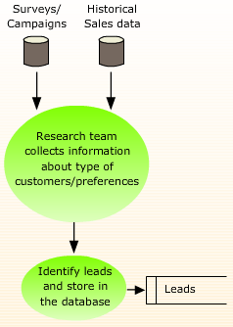
Implementing Information Systems in Marketing (Contd.)
The following figure depicts the process of collecting the customer information.

Slide 36
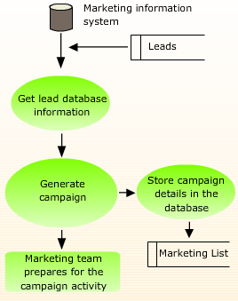
Implementing Information Systems in Marketing (Contd.)
The following figure depicts the process of preparing the campaign data.

Slide 37
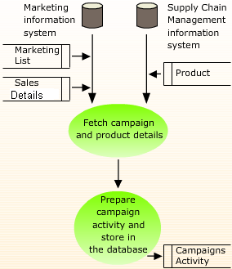
Implementing Information Systems in Marketing (Contd.)
The following figure depicts the process of launching the campaign.

Slide 38
Implementing Information Systems in Sales
Information systems in sales helps to record every transaction between the sales person and the customer.
The various aspects of sales data processed by using IS include:
  Managing financial transactions
  Providing inventory details
  Maintaining relevant customer information
  Integrating sales processes
Notes:
Use this and the next slide to explain the use of Information System in Sales.

Slide 39
Implementing Information Systems in Sales (Contd.)
Flow of Information in sales:
  The processes involved in the sales process that can be managed with the IS include:
    Identifying the prospective customers
    Approaching the prospective customers
    Managing purchase orders of the customers
    Delivering the product and closing the sale

Slide 40
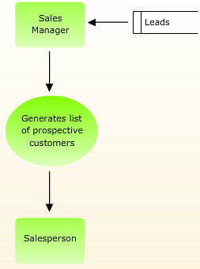
Implementing Information Systems in Sales (Contd.)
  The following figure depicts the process of identifying the prospective customers.

Slide 41
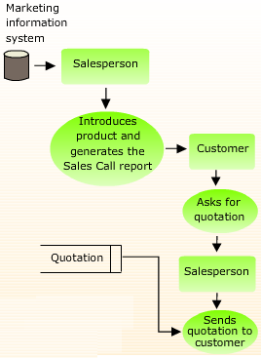
Implementing Information Systems in Sales (Contd.)
  The following figure depicts the process of approaching the prospective customers.

Slide 42
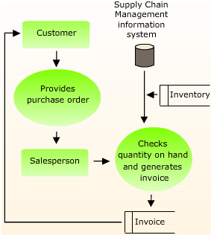
Implementing Information Systems in Sales (Contd.)
  The following figure depicts the process of managing purchase orders of customers.

Slide 43
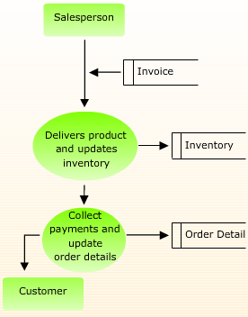
Implementing Information Systems in Sales (Contd.)
  The following figure depicts the process of delivering the product and closing the sale.

Slide 44
Summary
In this session, you learned that:
  Formulating various sales strategies includes:
    Defining Sales and Marketing
    Defining product and service standards which include:
      Identifying characteristics of a good product or service
      Identifying the need for service standards
  The different stages of a product lifecycle are:
    Introduction
    Growth
    Maturity
    Decline
  The stages in the marketing process are:
    Analyzing the need for product
    Deciding upon the marketing strategy
    Implementing the marketing strategy
    Monitoring the product
Notes:
Use this and the following slides to summarize the key concepts of the session to the students.

Slide 45
Summary (Contd.)
  An efficient sales process involves the following stages:
    Identifying the sales logistics
    Identifying the selling situations
    Recording the sales transactions
    Analyzing the sales results
  The processes involved in the marketing process that can be managed with IS include:
    Collecting customer's information
    Preparing campaign data
    Launching the campaign
Notes:
Use this and the following slides to discuss the key points of the session with the students.

Slide 46
Summary (Contd.)
  The processes involved in the sales process that can be managed with the IS include:
    Identifying the prospective customers
    Approaching the prospective customers
    Managing purchase orders of the customers
    Delivering the product and closing the sale
Notes:
Use this and the following slides to discuss the key points of the session with the students.

